Slide 1
Examining the Interplay Between Politicians' Facial Expressions in Media Images and News Corporation Bias
Chenfeng LI
Department of Statistics, UChicago
19th April, 2024
Advisor: Prof. Aaron Schein

Slide 2
Introduction and Background

Slide 3
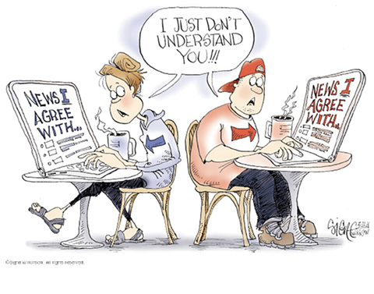
Media Bias
News corporations in US often exhibit progressive or conservative views on political issues.
Hypothesized reasons for media bias
Political ideologies of journalists and editors
Funding source
Preference of readers
Influences of Media Bias
Reflect of broader social structures and cultural values
Lead readers away from the truth by presenting skewed viewpoints or omitting facts
Distort public perception and undermine informed decision-making
Notes:
Regarding to the political issues, the news corporations in United states often have various progressive or conservative view. This is call the media bias.

Slide 4
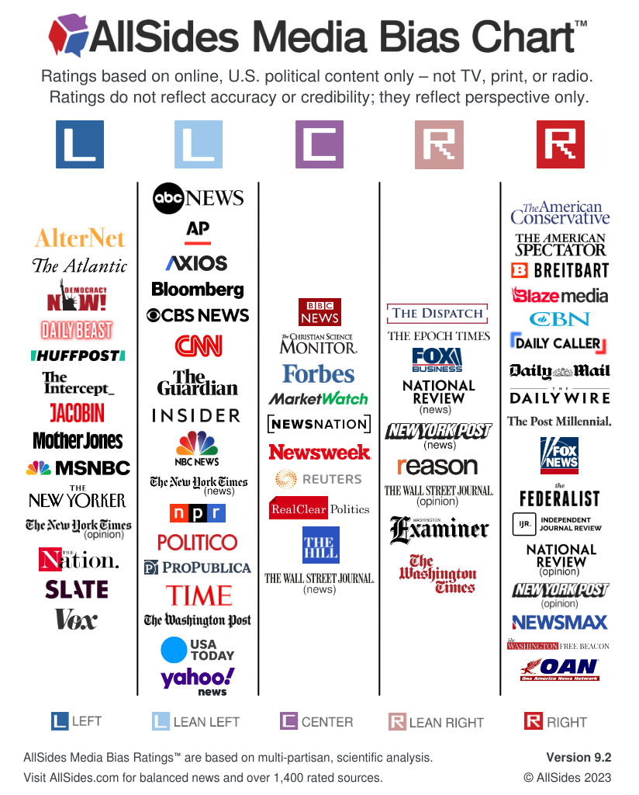
Media Bias Analysis
AllSides
Editor reviews, blind bias surveys, third-party data, and community feedback .
Ad Fontes Media
Rate by a team of 60 pretrained analysts.
Matthew Gentzkow and Jesse Shapiro
Identify commonly used phrases from different parties.
Calculate political lean index for news outlets.
Guo et al
Implement Mask Language Model to predict the masked tokens from news articles
Notes:
There are many organizations or researchers analyze the media bias in different ways.

Slide 5
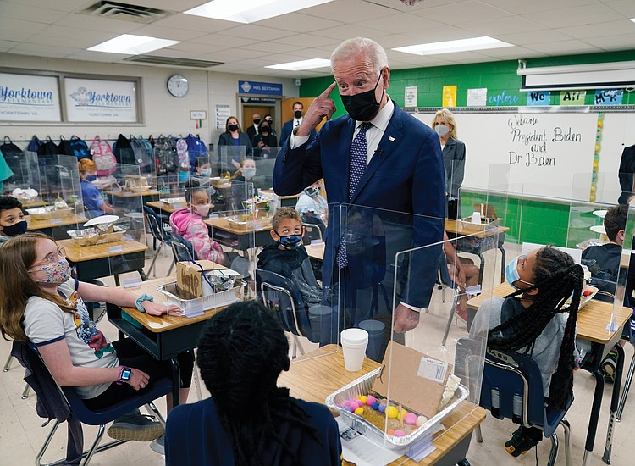
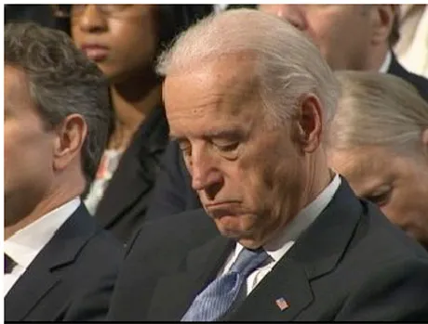
Selection of Politicians Photos
Maria Grabe and Erik Bucy: Image Bite Politics: News and the Visual Framing of Elections.
Highlighted the significant impact of image usage on shape the perceptions of viewers during elections.
Often exceed the influence of text.
Selection Aspects:
Behaviors
Facial Emotions
Photographic Angles and Composition
Notes:
For example, candidates with the image above in the news articles are more likely to be favored by voters.

Slide 6
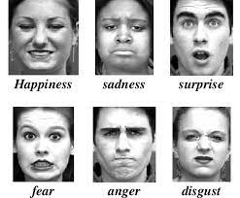
Facial Emotions
Paul Ekman
Six basic and separable emotions
Happiness, sadness, surprise, fear, anger, disgust
Du et al
Fifteen compound emotions from the basic ones
e.g. happily surprise and angrily surprise
Notes:
Distinguisable
We can treat a facial expression as a combination of the six basic emotions.

Slide 7
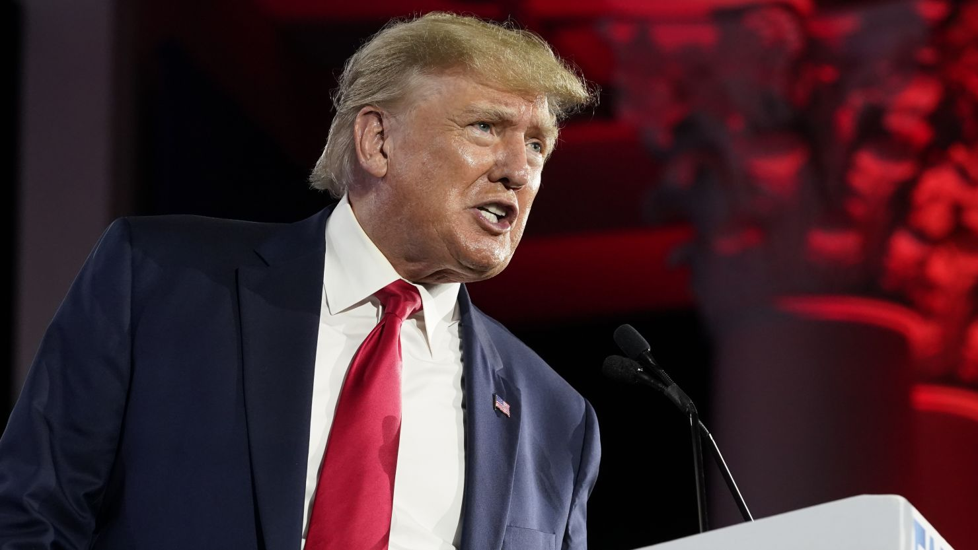
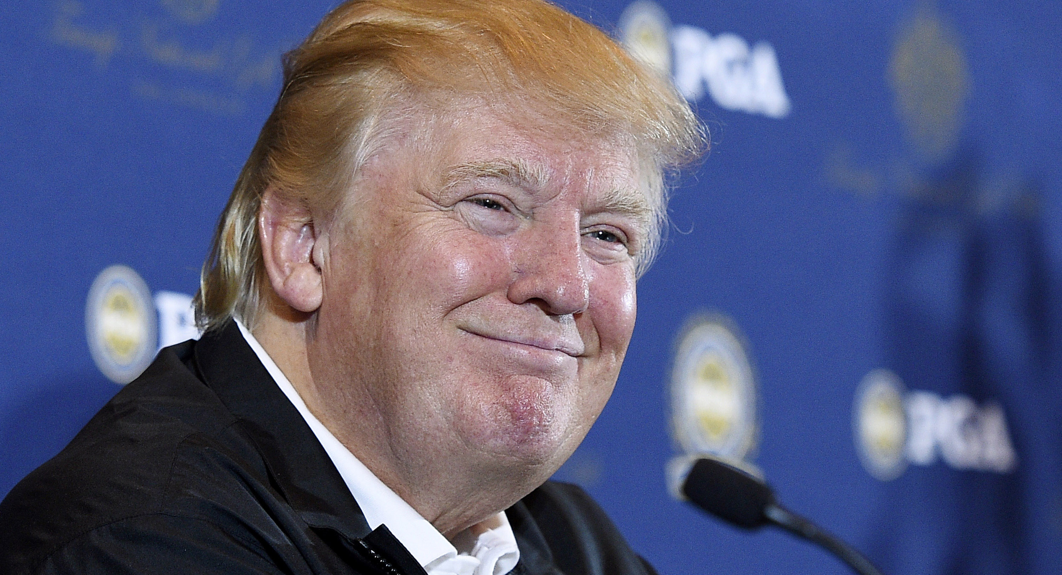
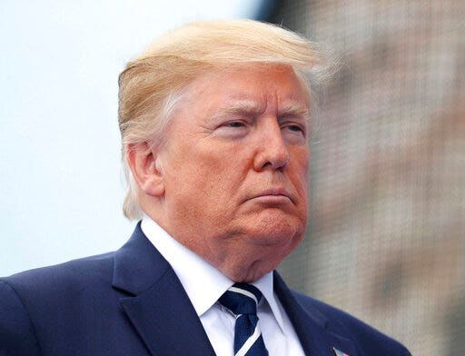
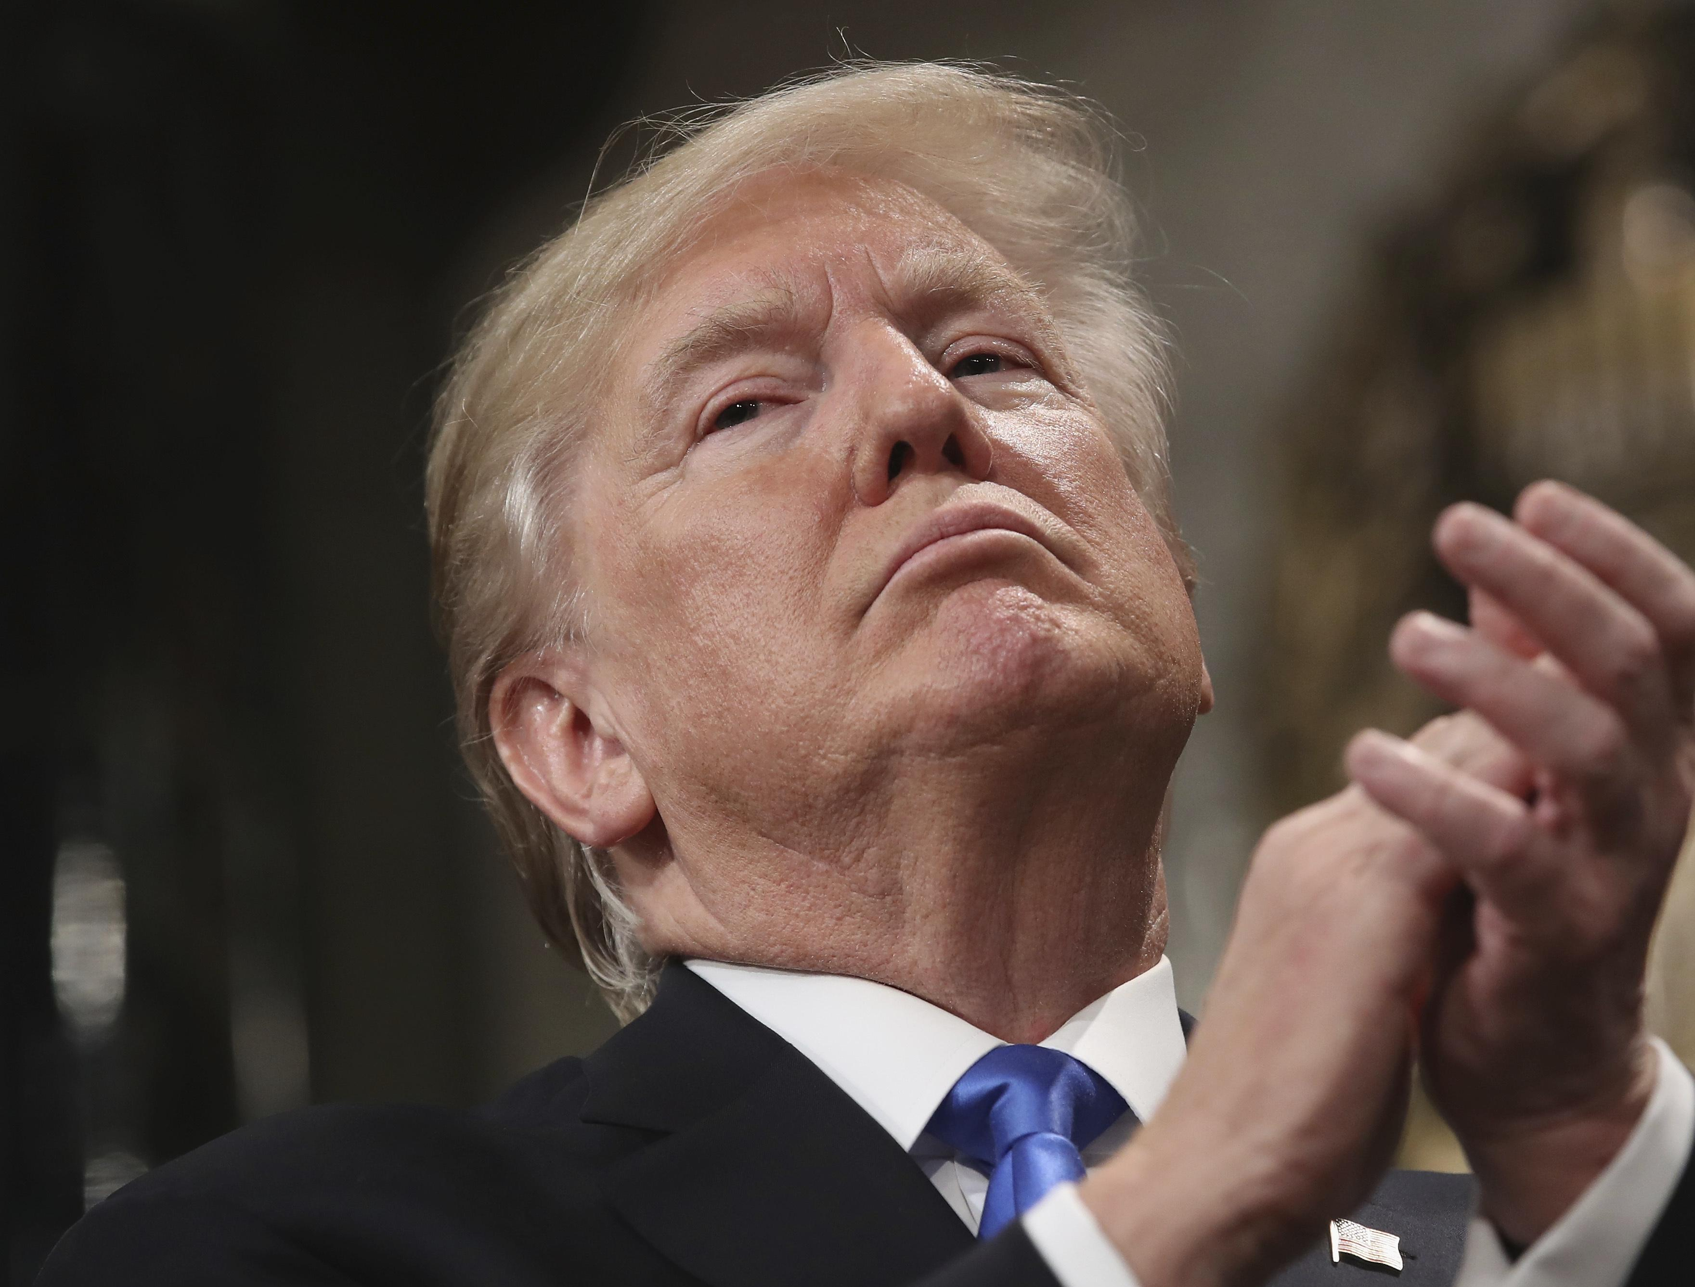
Research Question
Left
Do news corporations with different political biases select images of specific influential politicians that reflect varying preferences in facial expressions?
CNN
Politico
Right
Fox News
Washing Times

Slide 8
Data Preparation

Slide 9
Dataset
Columns | Examples
UUID | b85aa64d-411f-11ee-a96e-33dec8f414a2
Title of Article | Laura Loomer Files RICO Case Against Twitter and Facebook
Image URL | https://media.breitbart.com/media/2020/07/Jack-Dorsey-and-Twitter-employees.jpg
Image Caption | Jack Dorsey and Twitter employees (@Jack/Twitter)
Alternative Text | Jack Dorsey and Twitter employees
Image Type | ImageType.main
Source: Prof. James Turk
Updated: 7th Sep 2023
Contains 1,019,845 samples extracted from various news articles.
Cleaning the data
Remove the samples with empty URL or invalid URL (not starts with “http:” or “https:").
Remove duplicated samples.
Table: Metadata of the dataset
Notes:
It’s noticeable that we do not know the content of the images, (could be corporation’s logo, landscape, photos of one or several persons). We don’t know the source of the urls.

Slide 10
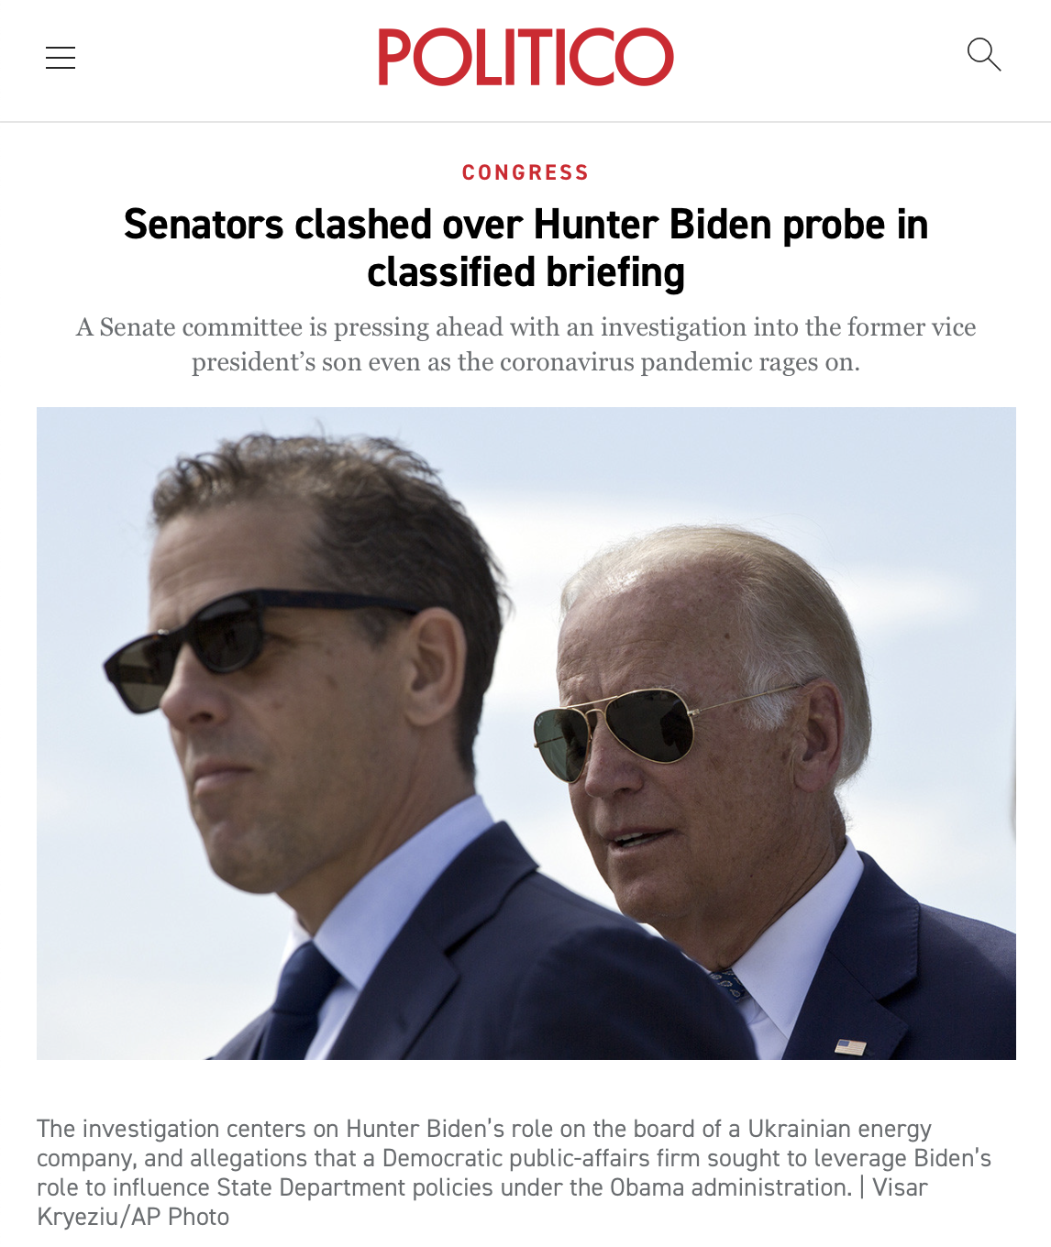
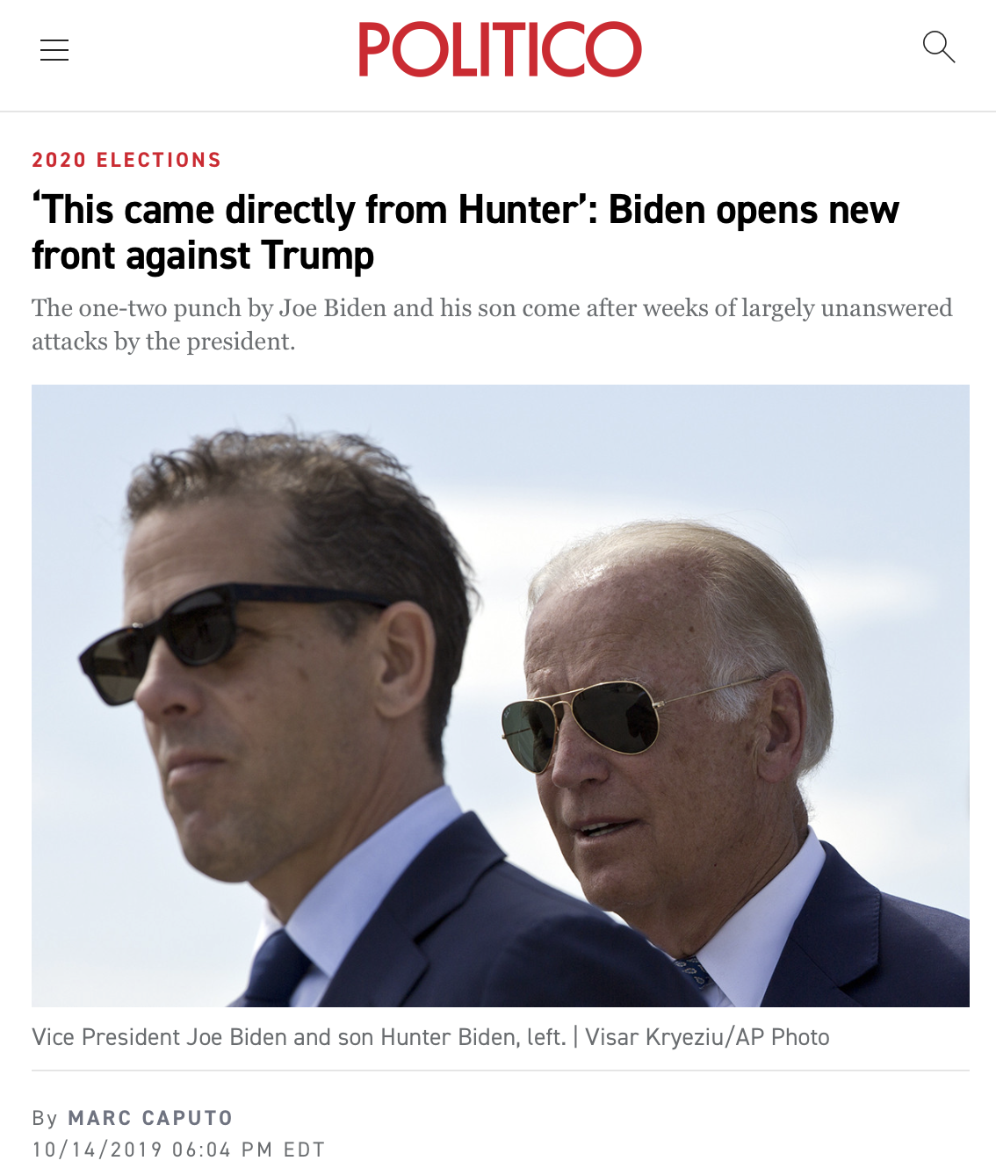
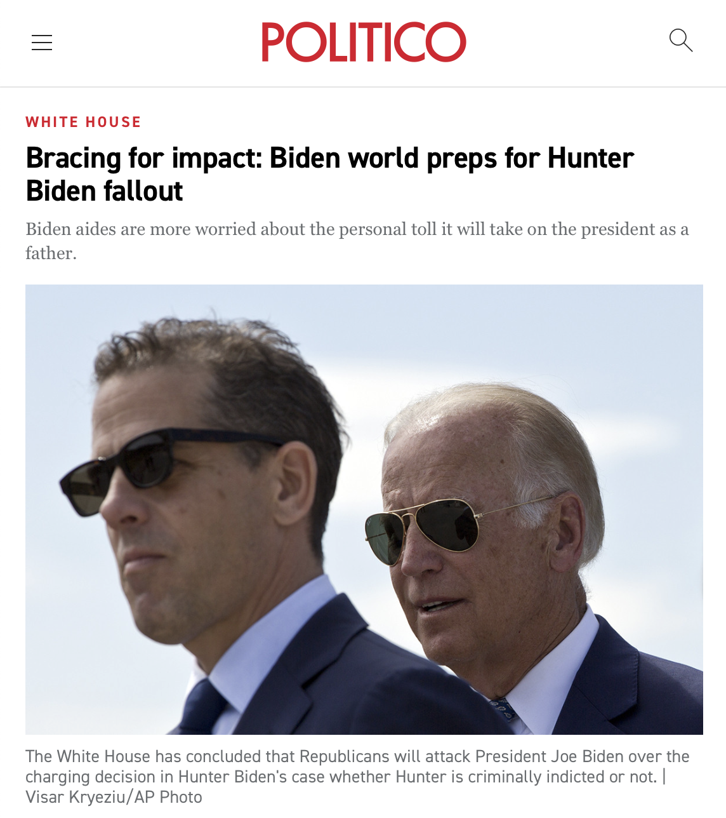
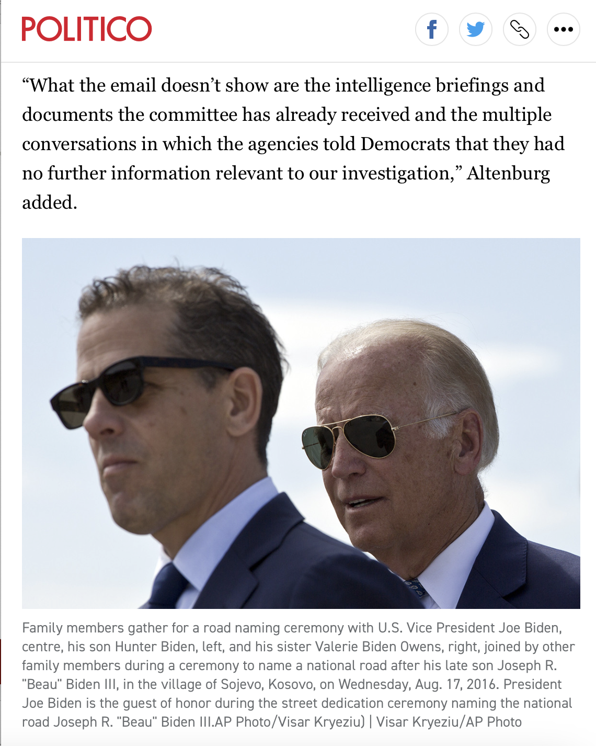
Duplicates Identification
Each UUID may correspond to different images.
Not using UUID as duplication indicator.
Textual elements may be absent.
Not simply using texts as indicator.
The media outlets reuse images across different reports.
Not simply using image URL as indicator.
Duplication indicator: group (Image URL, Texts).
Notes:
Duplicates not be removed: same images from the same article that appear under different URL.
Would discuss later.

Slide 11
Source of Images
Corporation | Political Bias | Sample Size
CNN | Left | 21,401
NPR | Left | 76,385
Politico | Left | 312.448
APNews | Left | 4,658
Washing Times | Right | 104,421
DailyCaller | Right | 145,019
FoxNews | Right | 96,702
Breitbart | Right | 81,152
Others | N/A | 43
Source of a URL: second-level domain
Examples:
https://static.politico.com/capny/sites/default/files/a-Uber%20HQ_0.
https://dailycaller.com/wp-content/uploads/2018/07/Michael-Ian-Black -Twitter-4.jpg
Remove the samples not from news corporations.
Identify the political bias of the news corporation from AllSides.
Dataset with 842,232 samples.
Notes:
The sample sizes of right medias are all around 100 k, while the Politico dominates the Left medias.

Slide 12
Methodologies

Slide 13
Pretrained Models
FaceNet
Robust facial recognition system developed by researches from Google.
Structure of FaceNet model implemented on pytorch:
Facial Detection:
MTCNN (Multi-task Cascaded Convolutional Networks)
Output a list of facial characteristic matrices and their rectangular coordinates.
Facial Recognition:
InceptionResnetV1 model
Pass a facial characteristic matrix and obtain a face embedding vector of dimension 8631.
Could compare the similarity of faces using the Euclidean distance between embedding vectors.
Residual Masking Network (RMN)
A facial expression recognition model introduced and trained by Pham et al.
Input a face crop and the obtained an emotion logit of dimension 7.
The emotion logit represent a compound of six basic emotions and the neutral face.

Slide 14
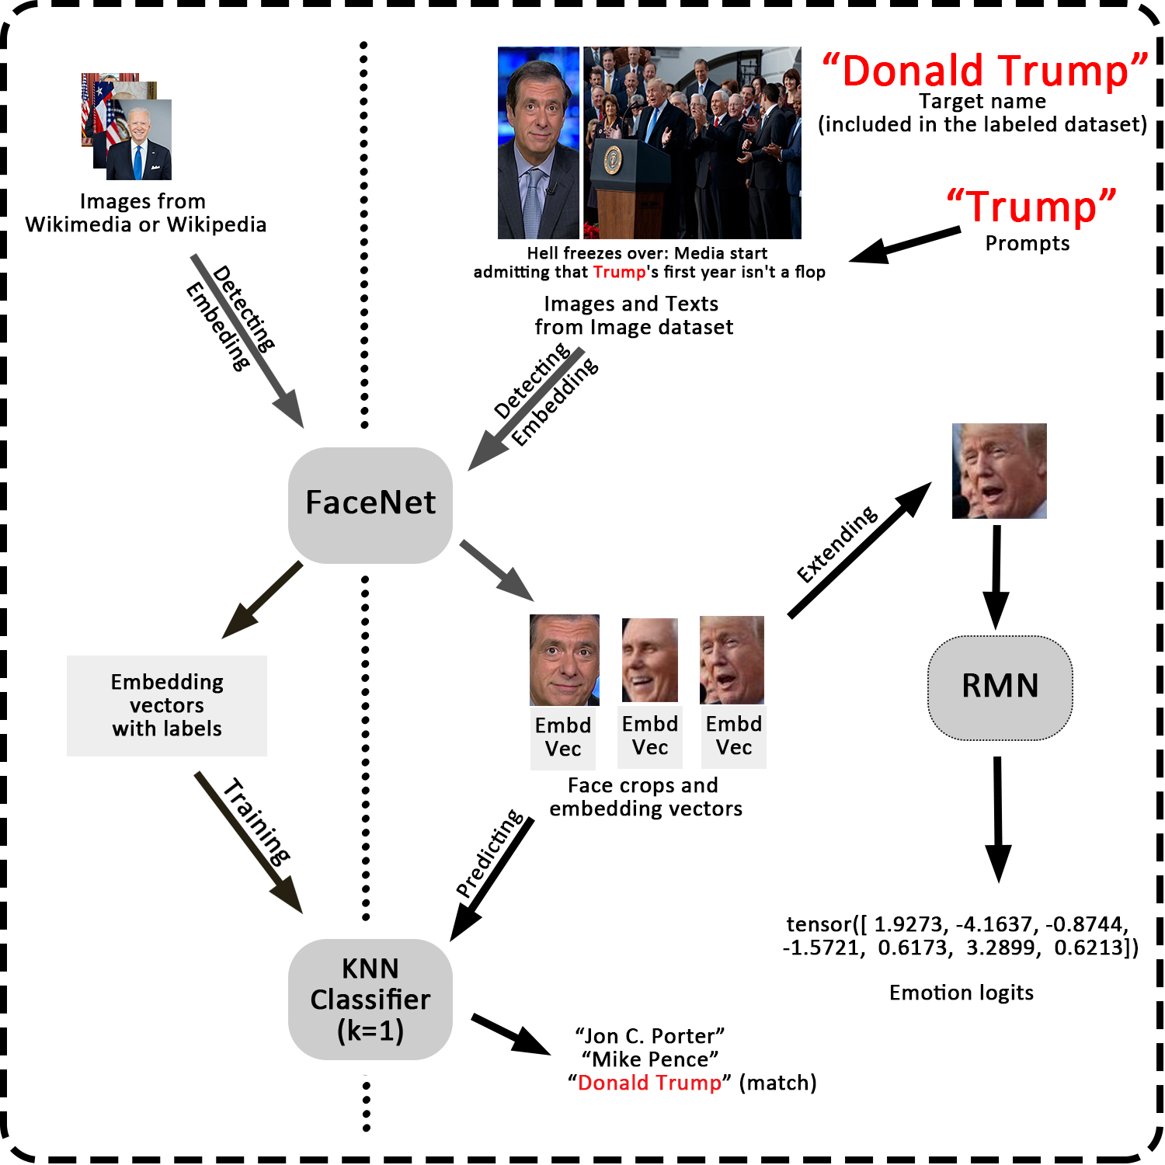
Overview of Methodology
Three steps of methodologies:
Build a name recognition model.
Get the face crops of some specific politicians from the dataset.
Obtain emotion logits from the face crops.
Results presenting
Visualize the emotion logits through UMAP.
Build a classification model.

Slide 15
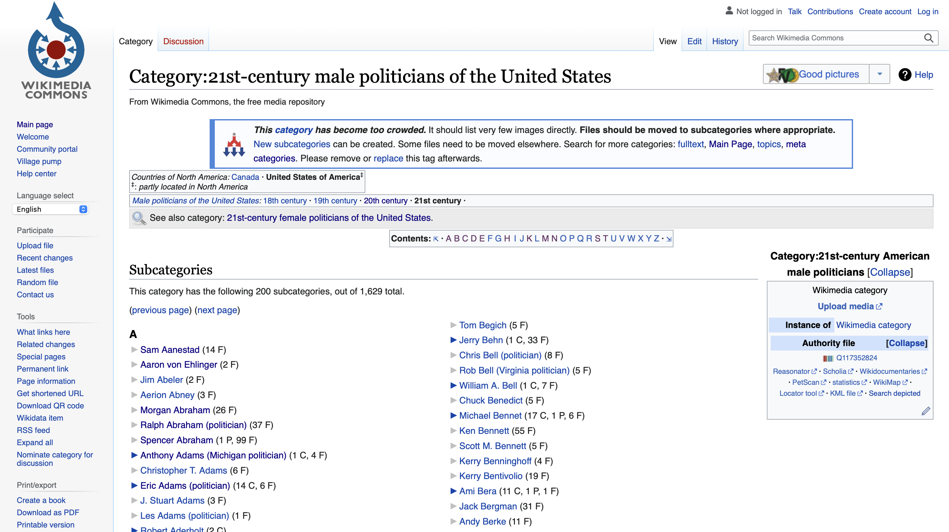
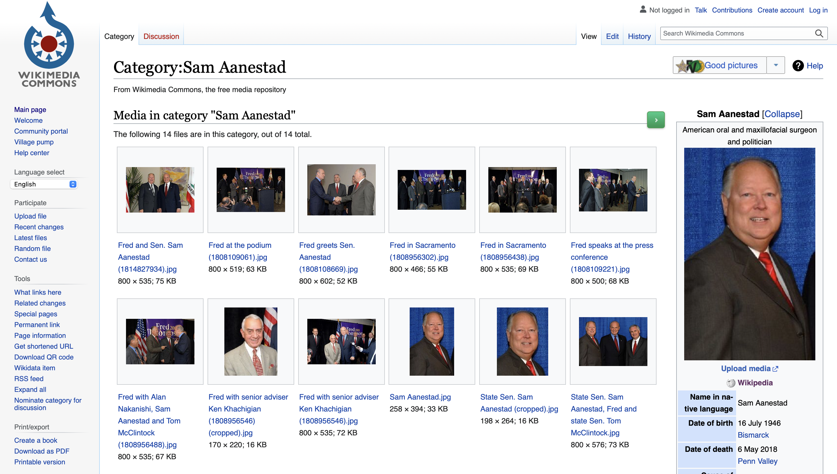
Name Recognition Model
Build a name recognition model model:
Determine the existence of faces from an input image.
Identify the names associate with those faces
Politicians Name-Face image dataset:
Wikimedia and Wikipedia galleries
Category:21st-century male politicians of the United States
Category:21st-century female politicians of the United States
Category: 21st-century businesspeople from the United States

Slide 16
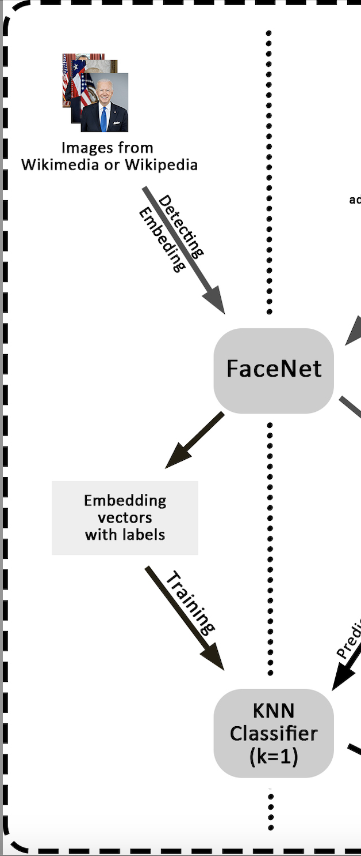
Name Recognition Model
For each politician from the WIKI categories:
Fetch the images under his/her page.
Pass the portrait through FaceNet to get the control face embedding.
Portrait: first image in the page of a politician containing exactly one face.
Shuffle the images.
Pass the images through FaceNet, and compare the embedding vectors with the control embedding vector.
If the Euclidean distance is less than 200, store the embedding vector.
10 embeddings (include the control one) at most.
Face-name dataset with 37,934 vectors from 9,308 politicians.
Train a Name Recognition Model using KNN model (with K=1).
Validation Accuracy: 80.6%, much higher than baseline accuracy 0.01%.

Slide 17
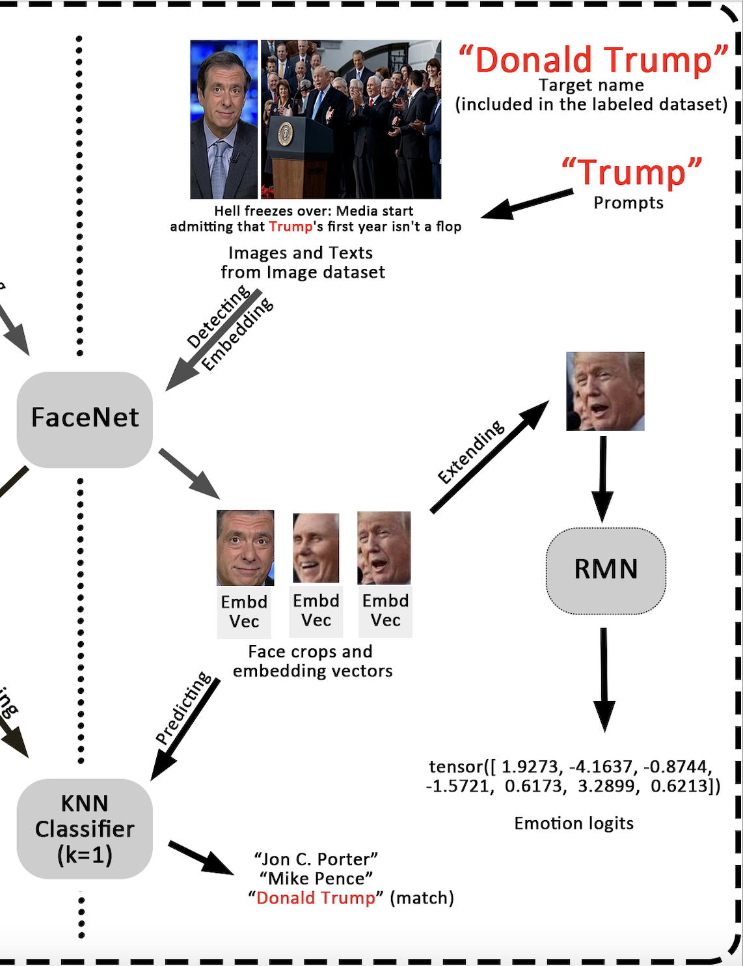
Face Crops for Influential Politicians
Specify the target name.
Choose a prompt close relevant to the target name.
Filter the news image dataset to keep the samples with their text part containing the prompt.
Pass the remaining images to the FaceNet model to obtain the face embeddings and the corresponding rectangular coordinate of face crops.
Pass the face embeddings to name recognition model.
For each embedding vector, if the predicted name match the target name, store the coordinate.
Store at most 2,000 face crops for each news corporation.

Slide 18
Three Questions
The name recognition model has limitation.
It always give wrong prediction for the face other than the 9,308 politicians from the face-name dataset.
Why do we focus on the influential politicians?
Why do we use prompts?

Slide 19
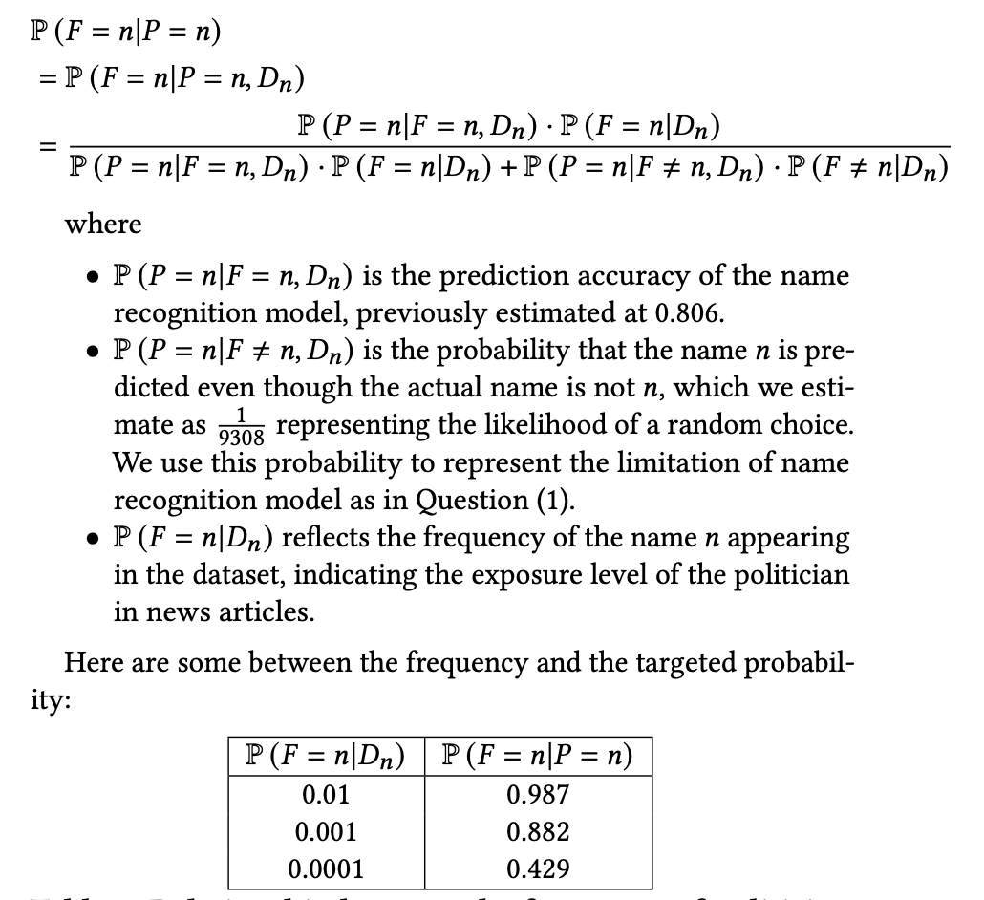
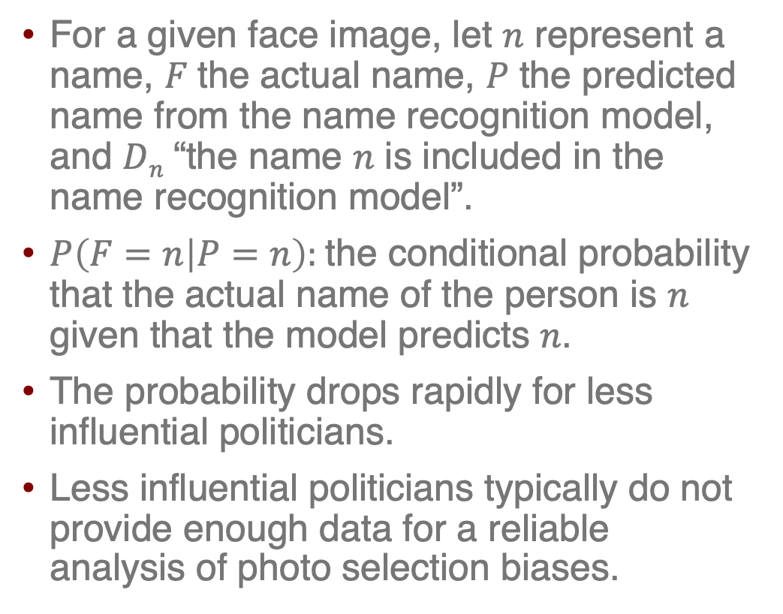
Without using prompts
For a given face image, let $n$ represent a name, 𝐹 the actual name, 𝑃 the predicted name from the name recognition model, and 𝐷_{𝑛} “the name 𝑛 is included in the name recognition model”.
$P\left(F=n | P=n\right):$the conditional probability that the actual name of the person is 𝑛 given that the model predicts 𝑛.
The probability drops rapidly for less influential politicians.
Less influential politicians typically do not provide enough data for a reliable analysis of photo selection biases.
Notes:
$P\left(F=n | P=n\right):$ a function of the frequency $P\left(F=n | D_{n}\right) :$

Slide 20
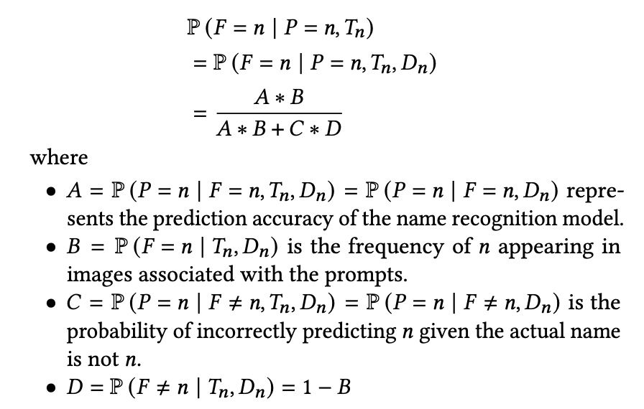
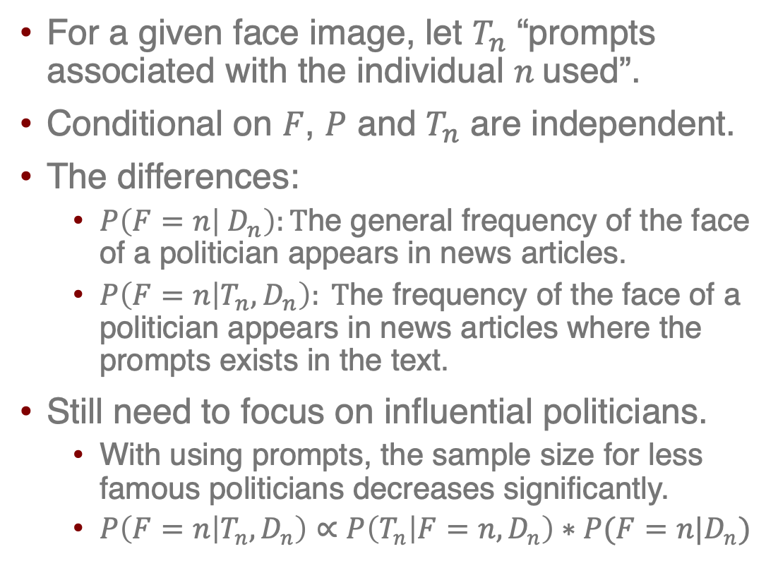
With using prompts
For a given face image, let $T_{n}$ “prompts associated with the individual $n$used”.
Conditional on $F$, $P$ and $T_{n}$ are independent.
The differences:
$P\left(F=n | D_{n}\right):T$he general frequency of the face of a politician appears in news articles.
$P\left(F=n | T_{n}, D_{n}\right): T$he frequency of the face of a politician appears in news articles where the prompts exists in the text.
Still need to focus on influential politicians.
With using prompts, the sample size for less famous politicians decreases significantly.
$P\left(F=n | T_{n}, D_{n}\right)∝P\left(T_{n} | F=n, D_{n}\right)∗P(F=n|D_{n})$

Slide 21
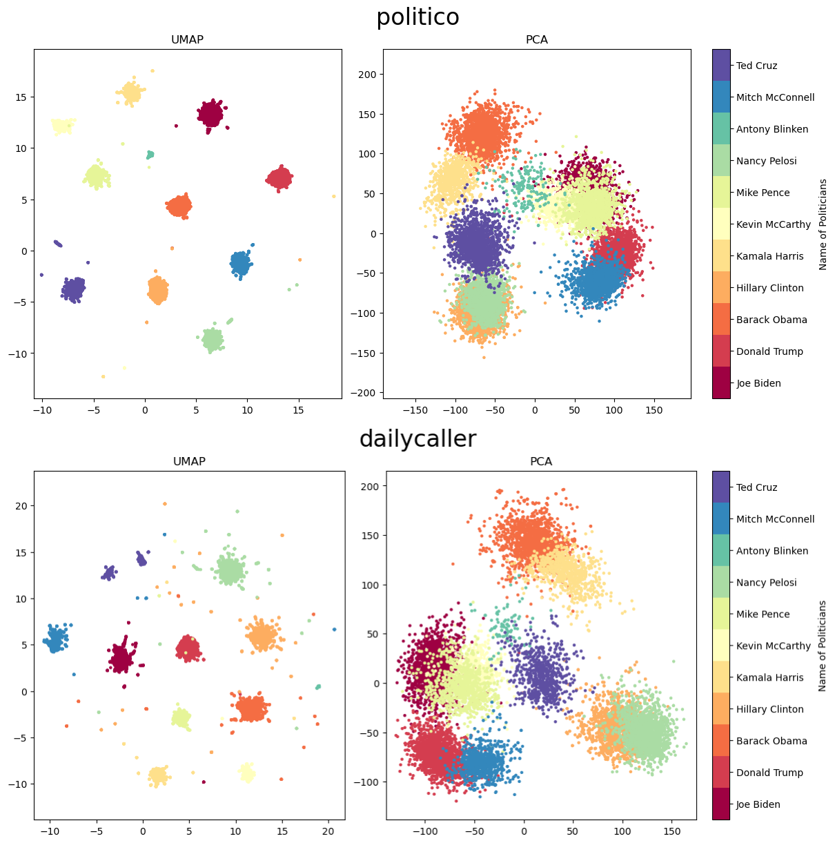
Visualization of Face Embedding vector
Reduce the dimension of face embedding vectors to 2 dimensional with UMAP and PCA
Plot the vectors with politician names as label.
The embedding vectors can clearly distinguish between different politicians.

Slide 22
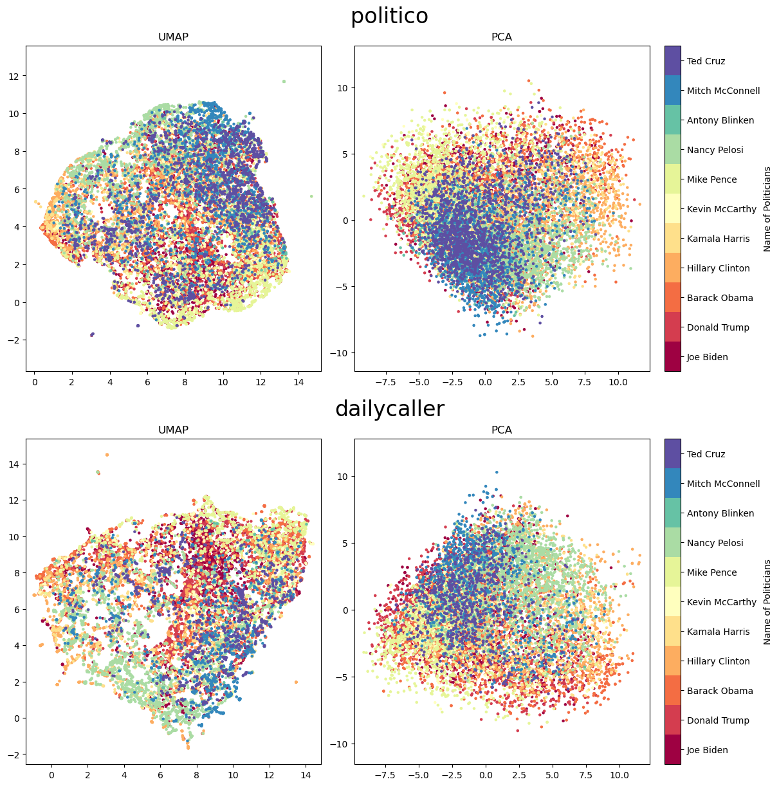
Emotion Logits
Extending the rectangular coordinates to square.
Convert the color from RGB to grayscale.
Fed the face crops to RMN model to obtain the emotion logits.
Plot the emotion logits after reducing the dimension with politician names as label.
Overlap: different politicians can exhibit similar expressions
Cluster: each politician has a commonly use set of facial expressions
Notes:
We have a dataset include the face crops, politician name and source news corporations.

Slide 23
Results

Slide 24
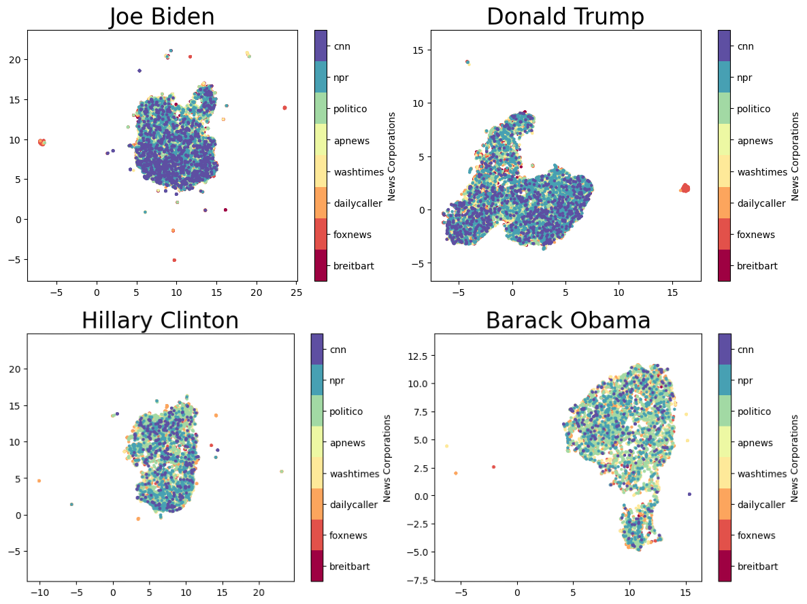
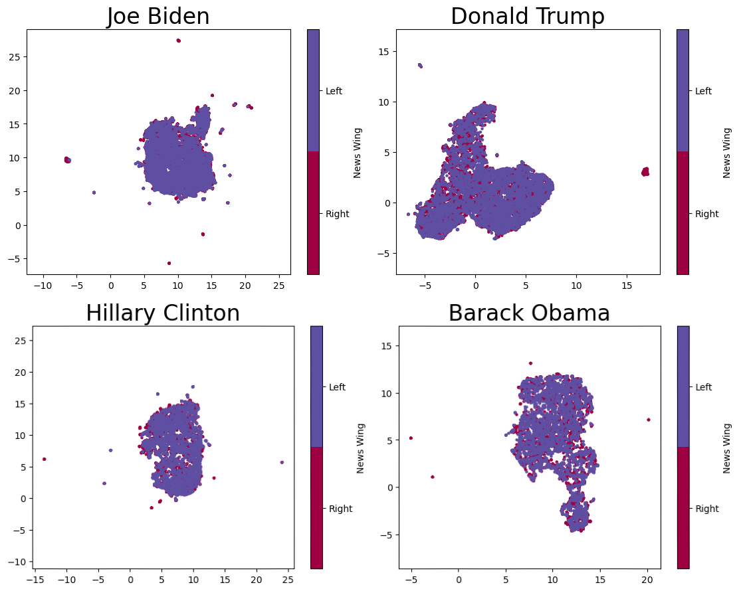
Visualization
Obtained the emotion logits from Biden, Trump, Clinton and Obama.
Plot after reducing the dimension with UMAP, with media or political bias as label.
Emotion logits may not be sufficient to classify the news corporation or political bias.
Notes:
Across Parties, Gender and Race

Slide 25
Classification Models
Two-dimensional vector may not capture the features of the emotion logits.
For each politician, train a KNN model with K=20 with the emotion logits and the news corporation / political bias as labels
Compare the validation accuracy with baseline (naively choose the largest categories).
Check the confusion matrices.
Plot the prediction label of validation set.

Slide 26
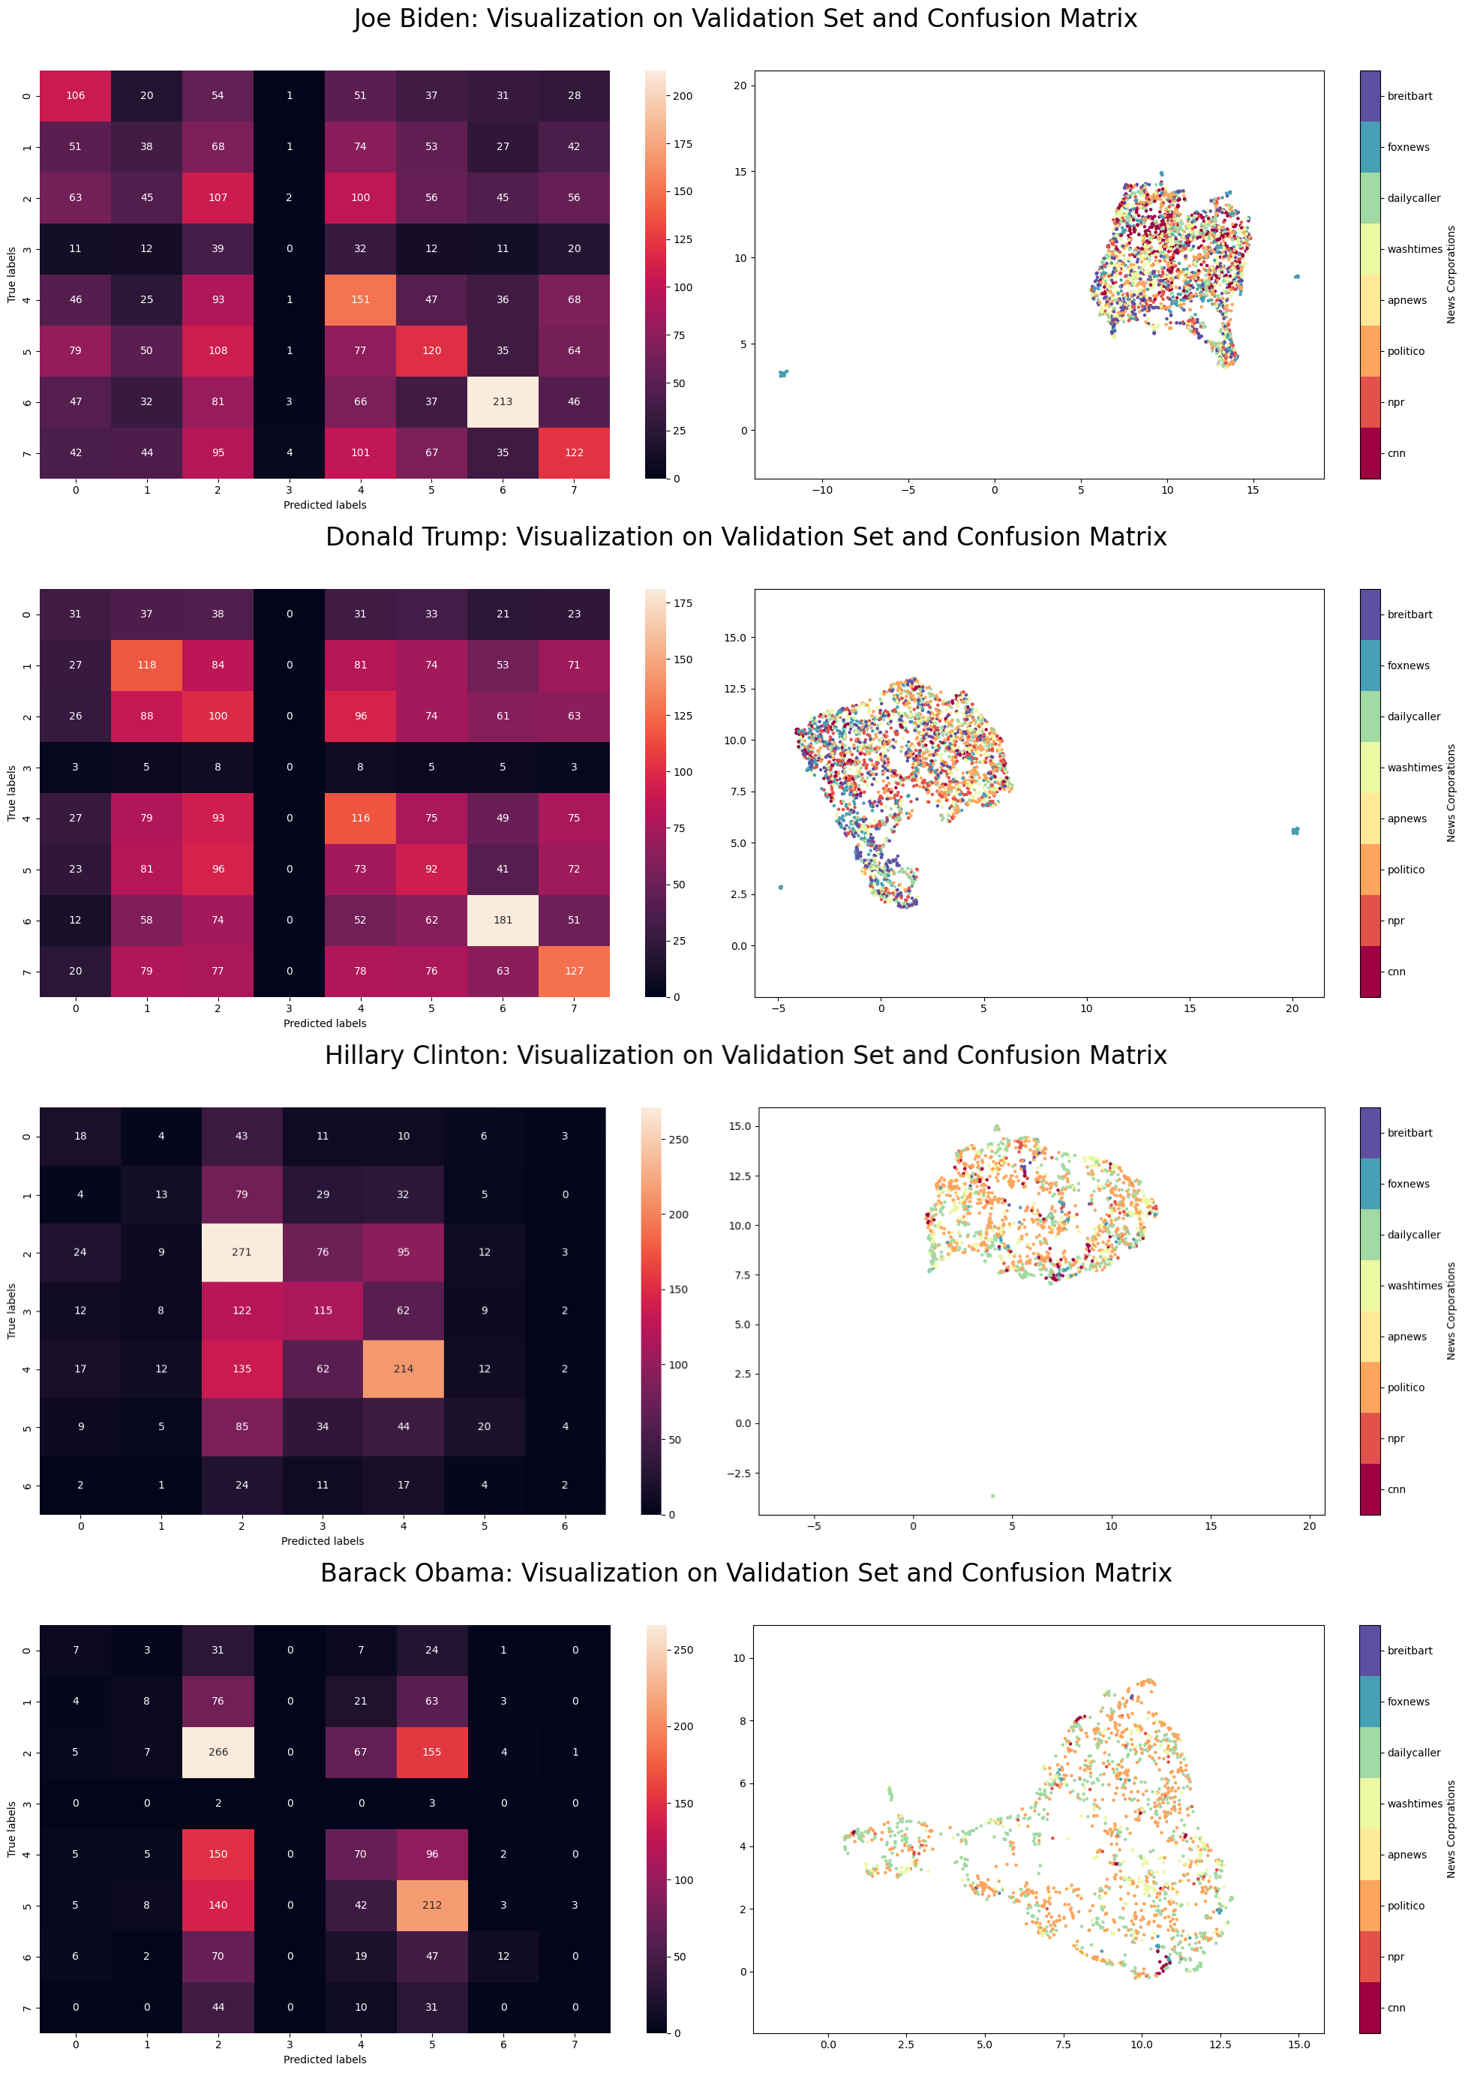
Classification Models (News Corporation)
Politician | Baseline Accuracy | Validation Accuracy
Joe Biden | 0.1502 | 0.2589
Donald Trump | 0.1530 | 0.2444
Hillary Clinton | 0.2789 | 0.3765
Barack Obama | 0.2874 | 0.3328
Validation accuracy is small.
Brightness of each column in confusion matrix are similar. High probability of wrongly prediction.
Significant overlap of emotion logits across different predicted corporations.
Reuse of image cause validation accuracy higher than baseline, and brightness of some diagonals.

Slide 27
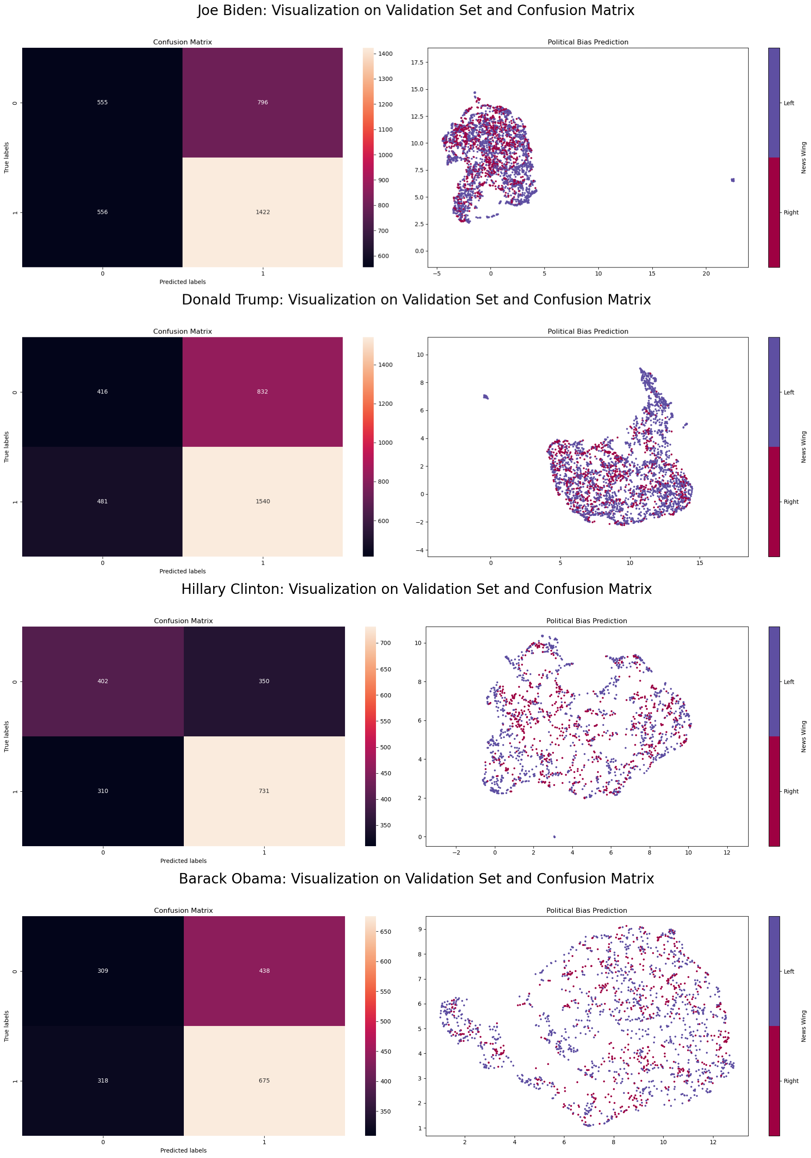
Classification Models (Political Bias)
Politician | Baseline Accuracy | Validation Accuracy
Joe Biden | 0.6008 | 0.5939
Donald Trump | 0.6119 | 0.5983
Hillary Clinton | 0.5669 | 0.6319
Barack Obama | 0.5701 | 0.5655
Validation accuracy is similar to baseline.
Significant overlap of emotion logits across different predicted bias.
Notes:
Indistinguishable

Slide 28
Discussion

Slide 29
Possible Reasons of the results
News corporations did not select facial expressions deliberately.
It may not be a sustainable strategy to continuously choose negative expression for politicians the media do not support.
Most readers seek neutral report. This strategy might risk alienating its existing audience.
Large news corporations seek for expanding the reader groups.
They may focus more on news articles and political commentaries rather than photo selection.
Limited representation of political bias across news corporations from the dataset
Absence of lots of mainstream outlets, e.g. NYT, WSJ, WP, etc.
The sample size of Politico far exceeds the ones of the other three left-leaning outlets.
The Politico dominates the left leaning outlets in this study.
For some politicians, the sample size of some news corporation is small.
Underfitting of classification model.
Lack of Deliberate Selection of Facial Expressions by News Corporations
Notes:
Intuitive reason

Slide 30
Possible Reasons of the results
Inadequate Representation of Facial Expressions by Emotion Logits.
Facial Expression is a complex mechanism. 7-D emotion logits may not be sufficient.
News corporations may use same expression to express different meaning.
For example, the dominate emotions of Donald Trump are ”angry” across eight outlets.
Progressive media might portray Trump as irritable and agitated, to criticizes his temperament and suitability for leadership.
Conservative media could emphasize his passion and assertiveness, as a symbol of strength and decisiveness.
The Impact of Timing on Photo Selection.
The political stance of some politicians may change over time, which could lead to a change in their perception of the media.
Notes:
Intuitive reason

Slide 31
Future Work
Creating a more comprehensive dataset
Includes a wider range of news corporations, larger sample size and publish date.
Explore the application of more sophisticated facial feature recognition model.
Generate higher dimensional vectors from face crops, which capture a broader array of facial feature.
Expand the target group to other public celebrities.
Implementation of Amazon Rekognition.
AWS cloud service.
Offer robust pretrained models that are highly effective in recognizing the names of celebrities and analyzing facial features.

Slide 32
Thank you!

